Slide 1




Desde las Profundidades del Kernel: Cómo Crear un Rootkit Invisible en WINDOWS
Descifrando el desarrollo de un Rootkit para Windows 11
[in/vazquez-vazquez-alejandro]
ViCONgal 2025, Galicia

Slide 2

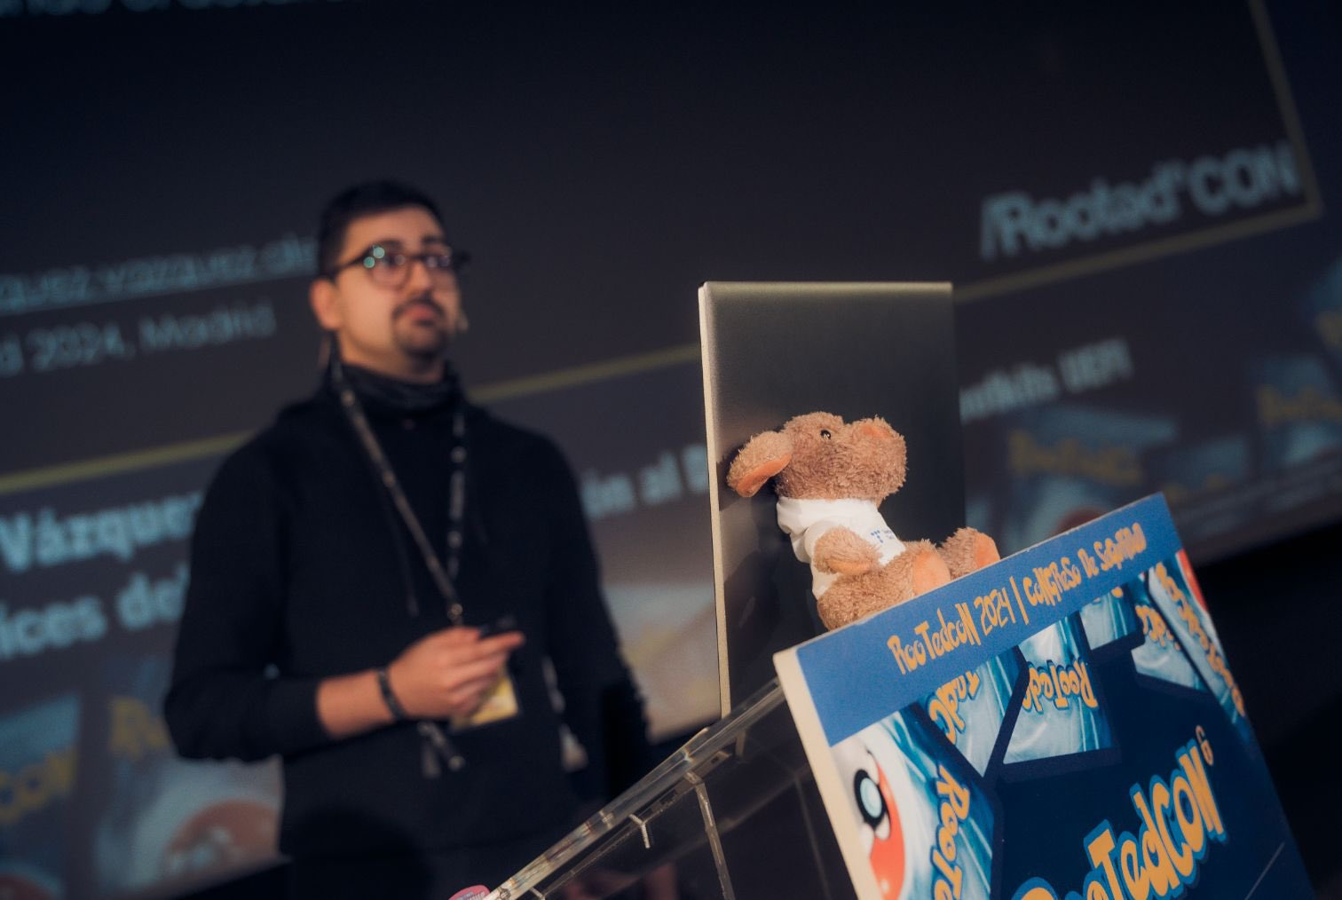

Whoami
FRIKI (Fanático de Revolucionar Internamente Kernels e Inicios del sistema)
Pastor de ovejas desde los 8 años
Me gusta el pulpo, de ahí los Rootkits
Docente en Máster de Análisis de Malware
[in/vazquez-vazquez-alejandro]

Slide 3


Table of Contents
Rootkit Development
Concepts
Kernel
Rootkit
Security Mechanisms
Checkpoint
Development Environment
Script
Kernel Mode Driver
Our Malicious Driver
Demo Time
Development
Communication, Keylogger
Hide Processes, Hide Folders
Network Control, Network Requests
Infection
B/Rootkits in the Wild
FudModule
Fire Chili
SPEcter
Demo Time

Slide 4


UEFI Bootkit Development

Slide 5
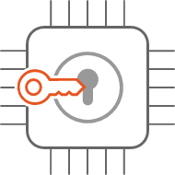
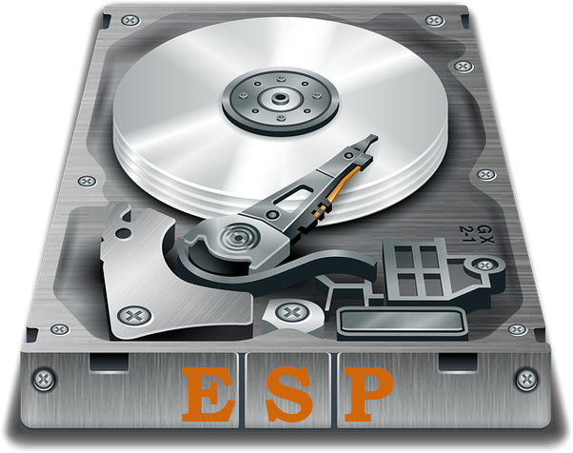
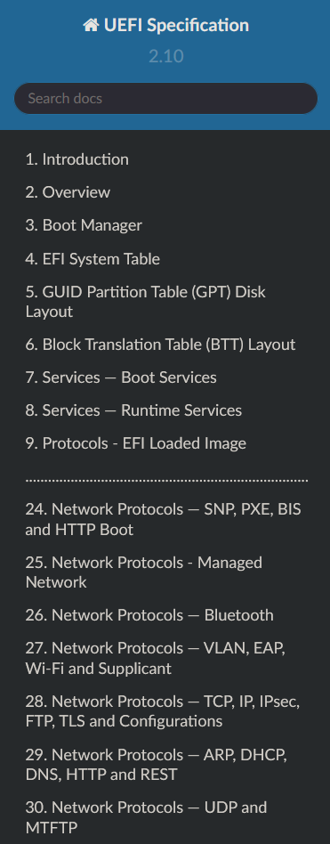
UEFI Bootkit Development
Boot order
Boot0001 = /EFI/Microsoft/boot/bootmgfw.efi
Boot0002 = /EFI/Ubuntu/shimx64.efi
Boot000x = /EFI/Vendor/bootx64.efi

Slide 6
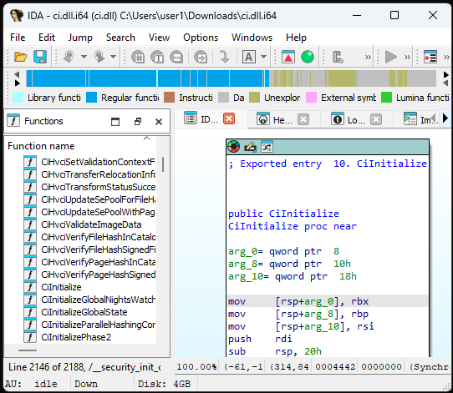
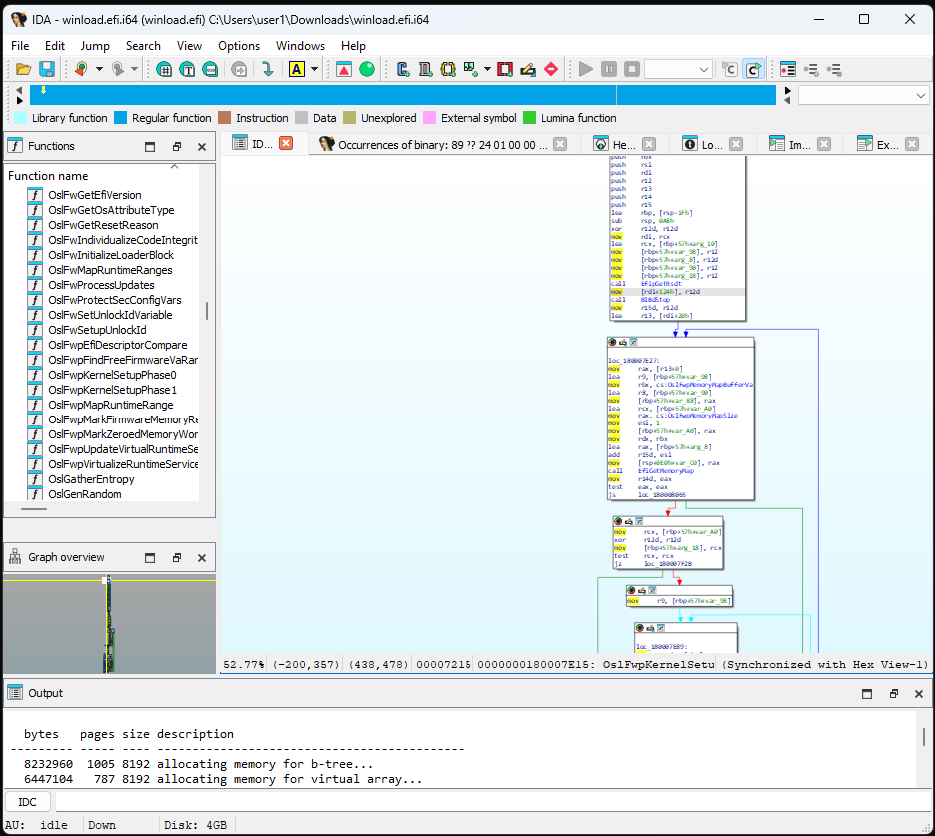
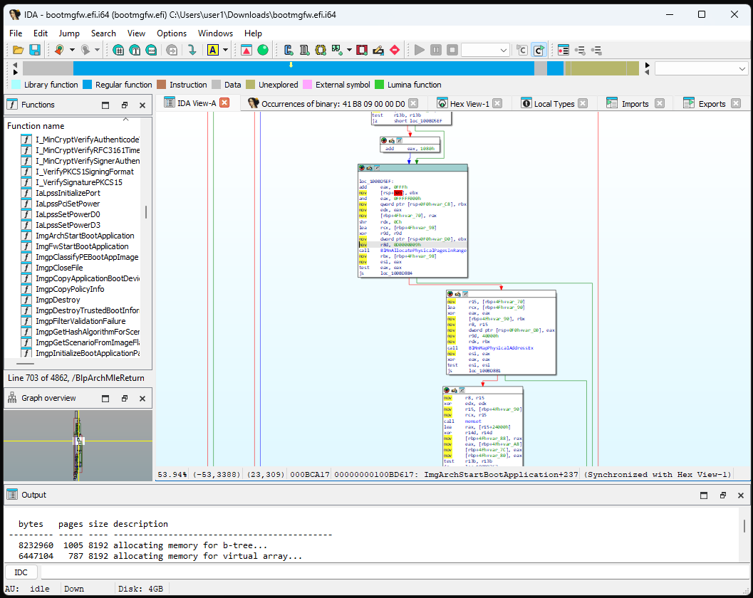
UEFI Bootkit Development
Boot order
Boot0001 = /EFI/Microsoft/boot/bootmgfw.efi
Boot0002 = /EFI/Ubuntu/shimx64.efi
Boot000x = /EFI/Vendor/bootx64.efi
Windows NT OS Kernel
%SystemRoot%\system32\
ntoskrnl.exe
Windows OS Loader
%SystemRoot%\system32\
winload.efi
Windows Boot Manager
\EFI\Microsoft\Boot\
bootmgfw.efi

Slide 7






UEFI Bootkit Development
Boot order
Boot0001 = /EFI/Microsoft/boot/bootmgfw.efi
Boot0002 = /EFI/Ubuntu/shimx64.efi
Boot000x = /EFI/Vendor/bootx64.efi
Windows NT OS Kernel
%SystemRoot%\system32\
ntoskrnl.exe
Windows OS Loader
%SystemRoot%\system32\
winload.efi
Bootkit
UEFI Application
bootmgfw.efi
DXE Runtime Driver
plus.efi
Windows Boot Manager
\EFI\Microsoft\Boot\
bootmgfw.efi

Slide 8


UEFI Bootkit Development
Boot order
Boot0001 = /EFI/Microsoft/boot/bootmgfw.efi
Boot0002 = /EFI/Ubuntu/shimx64.efi
Boot000x = /EFI/Vendor/bootx64.efi
Windows NT OS Kernel
%SystemRoot%\system32\
ntoskrnl.exe
Windows OS Loader
%SystemRoot%\system32\
winload.efi
Bootkit
UEFI Application
bootmgfw.efi
DXE Runtime Driver
plus.efi
Rootkit
Kernel-Mode Driver
driver.sys
Filter Driver
plus.sys
Windows Boot Manager
\EFI\Microsoft\Boot\
bootmgfw.efi

Slide 9

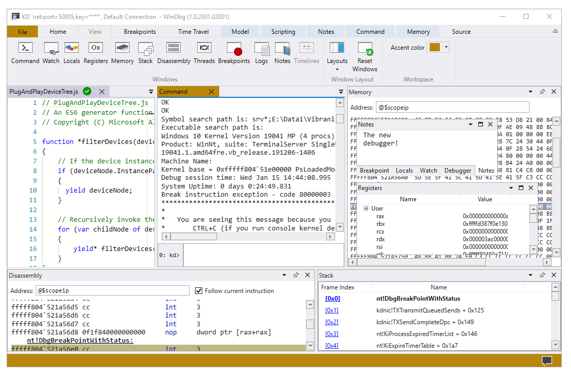



UEFI Bootkit Development
Boot order
Boot0001 = /EFI/Microsoft/boot/bootmgfw.efi
Boot0002 = /EFI/Ubuntu/shimx64.efi
Boot000x = /EFI/Vendor/bootx64.efi
Windows NT OS Kernel
%SystemRoot%\system32\
ntoskrnl.exe
Windows OS Loader
%SystemRoot%\system32\
winload.efi
Bootkit
UEFI Application
bootmgfw.efi
DXE Runtime Driver
plus.efi
Rootkit
Kernel-Mode Driver
driver.sys
Filter Driver
plus.sys
Windows Boot Manager
\EFI\Microsoft\Boot\
bootmgfw.efi

Slide 10
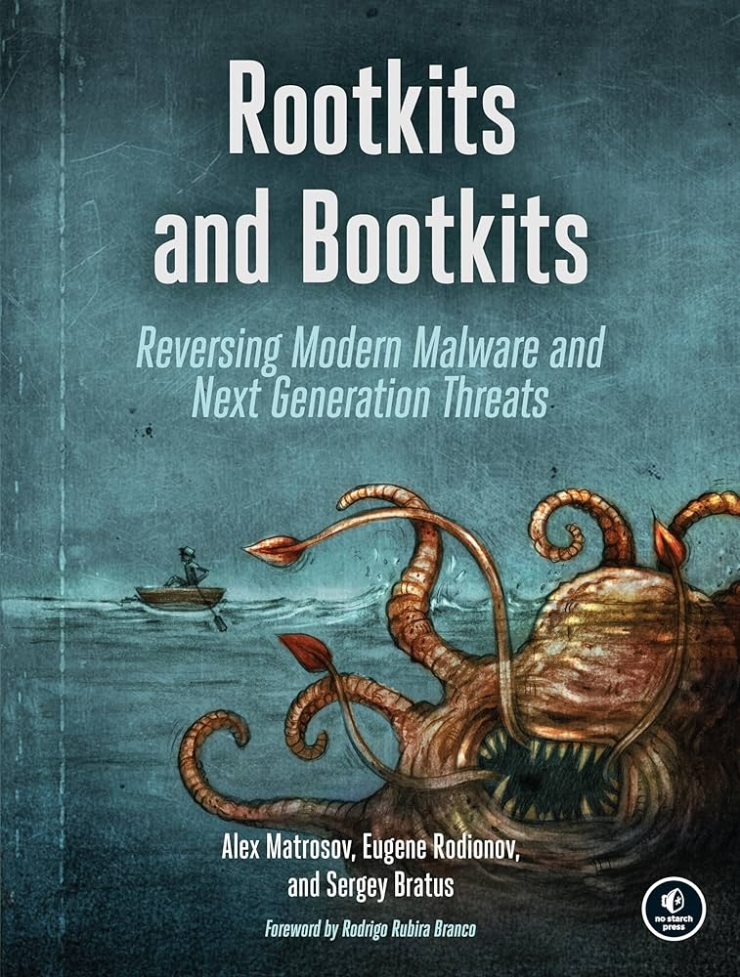
Rootkit
Rootkit: Sophisticated piece of malware that can add new code to the operating system or delete and edit operating system code. Rootkits may remain in place for years because they are hard to detect, due in part to their ability to block some antivirus software and malware scanner software.
~ Crowdstrike
Kernel-Mode Driver
C/C++ - driver.sys

Slide 11
Security Mechanisms
[Anti-Rootkit Installation]
Driver Signature Enforcement (DSE)
Windows won't run drivers not certified by Microsoft

Slide 12
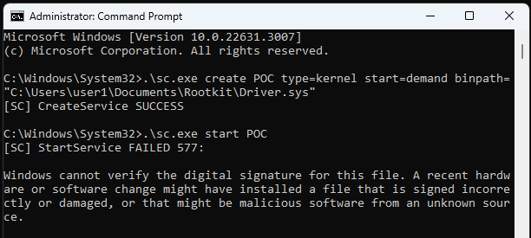
Security Mechanisms
[Anti-Rootkit Installation]
Driver Signature Enforcement (DSE)
Windows won't run drivers not certified by Microsoft
1
2

Slide 13
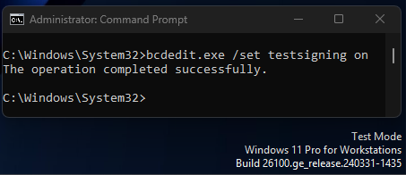
Security Mechanisms
[Anti-Rootkit Installation]
Driver Signature Enforcement (DSE)
Windows won't run drivers not certified by Microsoft
1
2

Slide 14
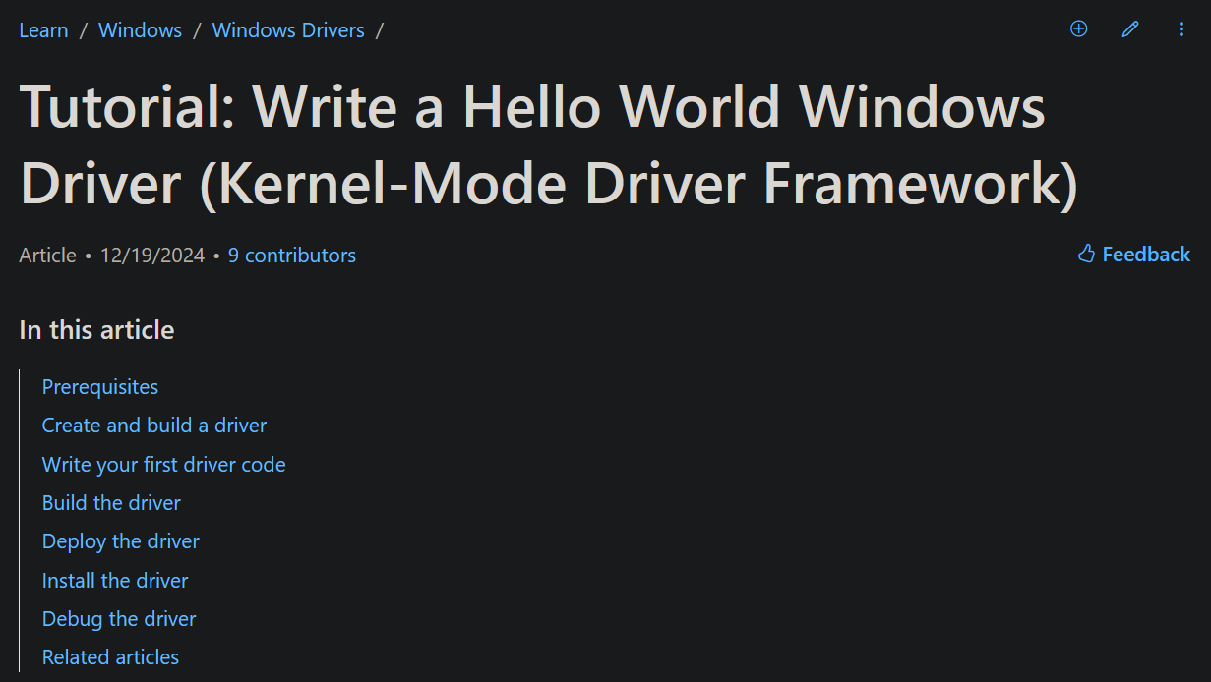
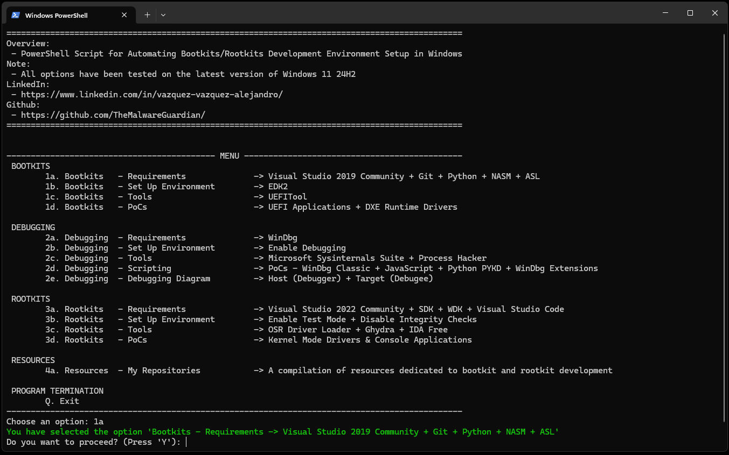

Development Environment

Slide 15
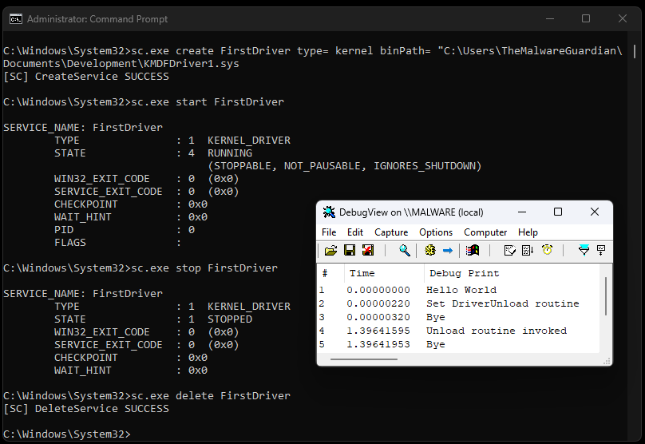
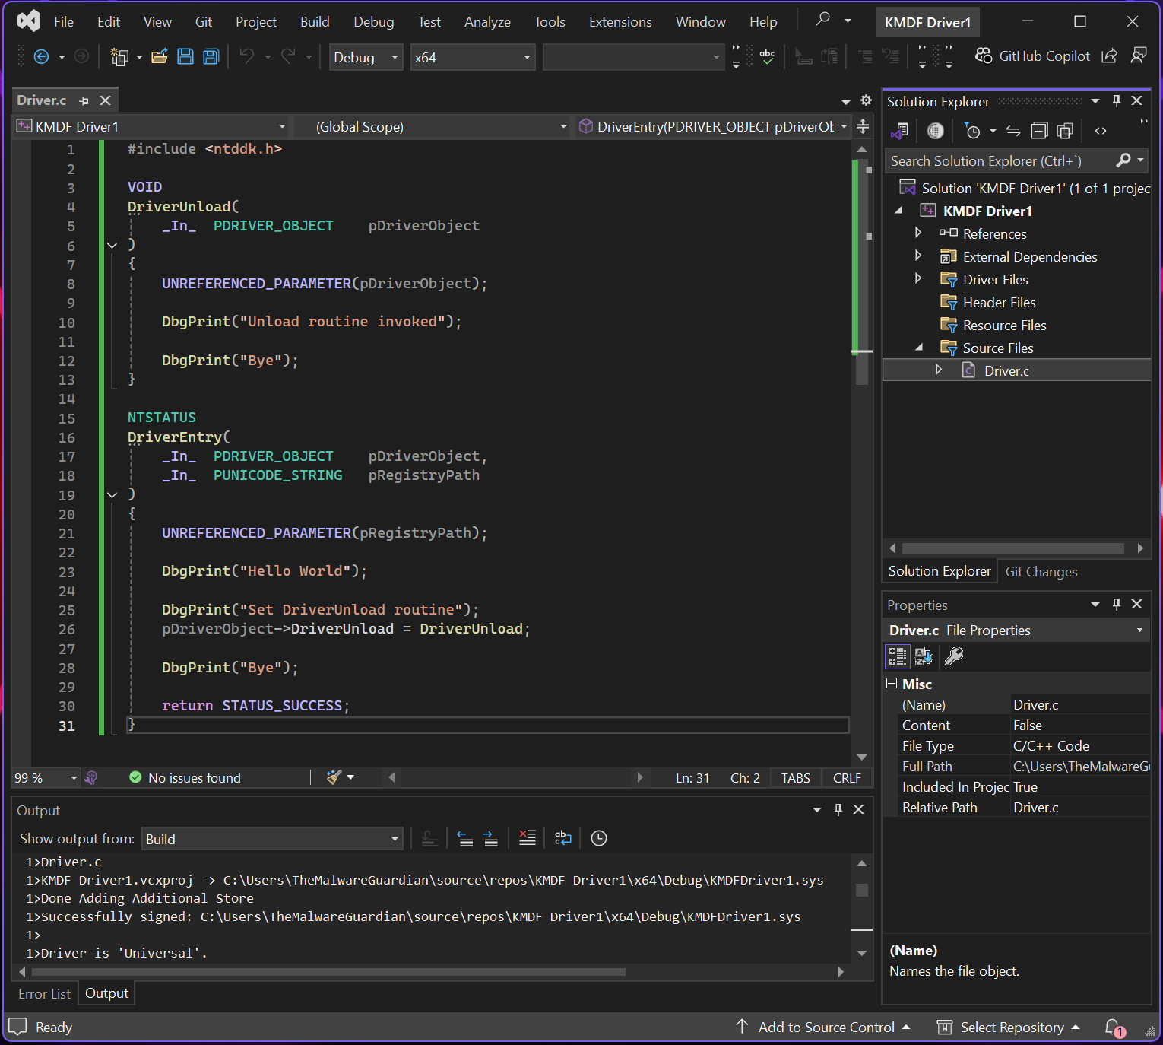
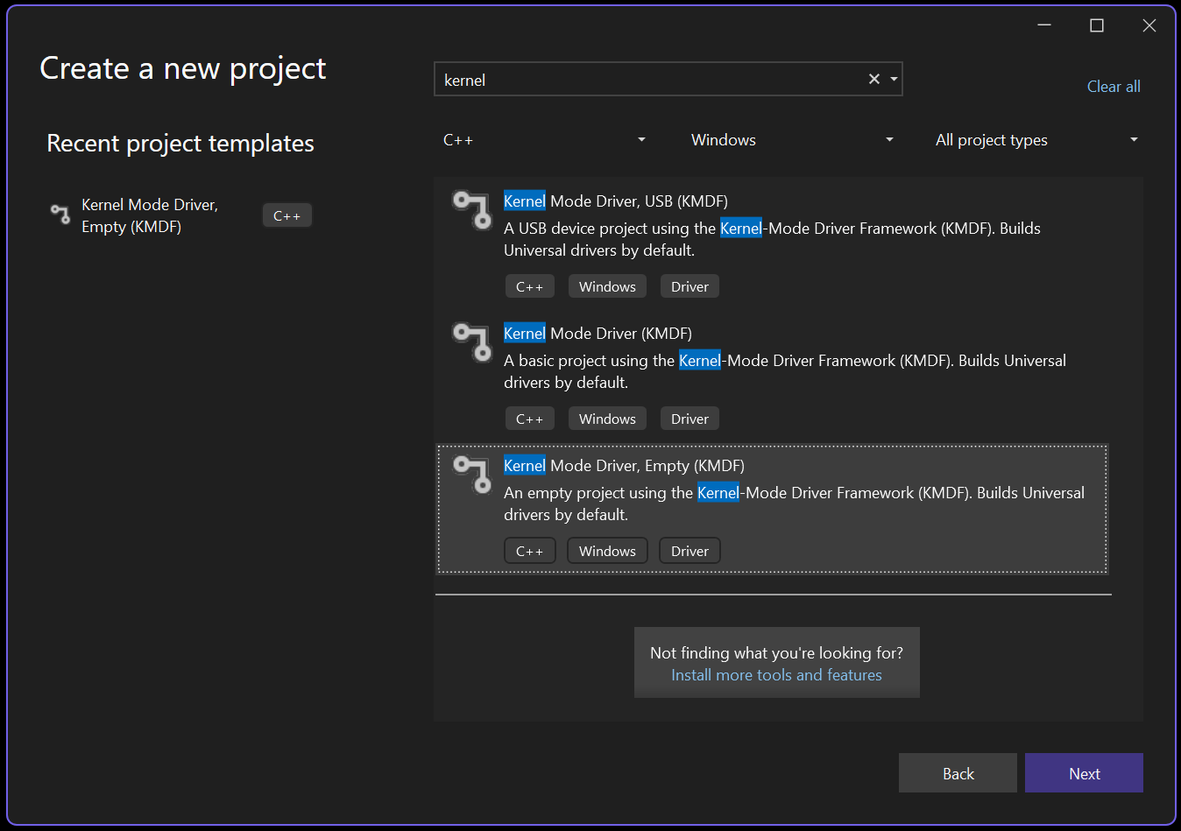
Kernel Mode Driver

Slide 16

Our Malicious Driver
Rootkit Development
User Mode - Kernel Mode Communication Toolkit
Direct Kernel Object Modification Hide Processes
Keyboard and Mouse Filter Keylogger
Windows Filtering Platform Network Control
Windows Kernel Sockets Network Requests
File System Minifilter Driver Hide Folders
ntddk.h
Communication
ntddk.h
DKOM
ntddk.h
Keyboard Filter
fwpmk.h, fwpsk.h, fwpmu.h
WFP
wsk.h
WSK
fltKernel.h
Minifilter

Slide 17


Slide 18



Communication
I
“The bridge between user mode and kernel mode: IOCTL requests initiate communication, while IRPs manage data exchange and driver actions.”
Via Input/Output Control Codes and Input/Output Request Packets
Via Filter Communication Ports
Via Network Requests
Via Shared Memory
Via Registry Keys
Via Files
Via …

Slide 19
Communication
User Mode
Kernel Mode
console_application.exe
kernel_mode_driver.sys
// -----------------------
#define IOCTL_COMM_0 CTL_CODE(FILE_DEVICE_UNKNOWN, 0x800, METHOD_BUFFERED, FILE_ANY_ACCESS)
// -----------------------
hDevice = CreateFile(L"\\\\.\\MyKernelDriver", GENERIC_READ | GENERIC_WRITE, ...
// -----------------------
BOOL success = DeviceIoControl(hDevice,
1 IOCTL_COMM_0,
2 inBuffer, sizeof(inBuffer),
3 outBuffer, sizeof(outBuffer),
&bytesReturned, NULL);
// -----------------------
#define IOCTL_COMM_0 CTL_CODE(FILE_DEVICE_UNKNOWN, 0x800, METHOD_BUFFERED, FILE_ANY_ACCESS)
// -----------------------
status = IoCreateDevice(...);
status = IoCreateSymbolicLink(...);
// -----------------------
pDriverObject->MajorFunction[...] = ...;
pDriverObject->MajorFunction[IRP_MJ_DEVICE_CONTROL] = DriverHandleIOCTLs;
// -----------------------
NTSTATUS
DriverHandleIOCTLs(
_In_ PDEVICE_OBJECT pDeviceObject,
_In_ PIRP pIrp
)
{
PIO_STACK_LOCATION stack = IoGetCurrentIrpStackLocation(pIrp);
ULONG controlCode = stack->Parameters.DeviceIoControl.IoControlCode;
switch (controlCode)
{
case IOCTL_COMM_0:
...
break;
case IOCTL_COMM_1:
...
break;
pIrp->IoStatus.Status = STATUS_SUCCESS;
IoCompleteRequest(pIrp, IO_NO_INCREMENT);
return STATUS_SUCCESS;
}
IRP
typedef struct _IRP {}
Handle IRP
IRP_MJ_DEVICE_CONTROL
Simbolic Link
"\\DosDevices\\MyKernelDriver"
Device Object
"\\Device\\MyKernelDriver"

Slide 20
Hide Proccesses
II
“Windows maintains a doubly linked list of active processes in (LIST_ENTRY) EPROCESS->ActiveProcessLinks. Unlink a process from the chain, and it disappears from user-mode enumeration.”
struct EPROCESS
{
…
LIST_ENTRY 0x1d8
{
FLINK
BLINK
}
…
}
struct EPROCESS
{
…
LIST_ENTRY 0x1d8
{
FLINK
BLINK
}
…
}
struct EPROCESS
{
…
LIST_ENTRY 0x1d8
{
FLINK
BLINK
}
…
}
struct EPROCESS
{
…
LIST_ENTRY 0x1d8
{
FLINK
BLINK
}
…
}
struct EPROCESS
{
…
LIST_ENTRY 0x1d8
{
FLINK
BLINK
}
…
}

Slide 21
Keylogger
III
“Keystroke interception in kernel mode: The Windows keyboard driver stack routes all keystrokes through a device object called \Device\KeyboardClass0. By attaching a driver to this device and registering a CompletionRoutine, we can capture raw keystroke data before it propagates to user-mode applications like text editors or browsers.”
Keyboard Class Driver
(kbdclass.sys)
\Device\KeyboardClass0
Keyboard Port Driver
(i8042prt.sys)
Keyboard Filter Drivers
(Optional 1..N)
Keylogger Driver
\Device\My Keylogger
Attached to intercept IRP_MJ_READ requests and set a CompletionRoutine to capture keystroke data.
User Mode
Physical Keyboard

Slide 22
Network Control
IV
“Windows Filtering Platform (WFP) allows real-time inspection and control of network connections. By attaching filters (static rules applied at specific layers of the network stack to identify traffic based on attributes like IPs or ports) and callouts (custom drivers that execute dynamic logic on flagged traffic), it’s possible to classify traffic based on metadata such as the remote IP address and the associated process. Traffic that matches specific rules can be blocked, logged, or modified, enabling comprehensive network security policies.”
Conditions
Layer 1
Filter A
Network Stack
Fields
Callout F
Conditions
Filter Engine
Filter B
Callout G
Layer 2
Conditions
Fields
Filter C
Conditions
Callout H
Layer 3
Filter D
Fields
Conditions
Filter E

Slide 23
Network Requests
V
“WinSock Kernel (WSK) allows kernel-mode programs to perform complex network operations, such as establishing connections, binding sockets, and transferring data. With support for asynchronous communication using IRPs, WSK enables efficient and controlled interaction with network protocols, ensuring low-latency communication and making it a robust solution for implementing kernel-level networking features.”
I/O Manager
WinSock Kernel (WSK)
TCP/IPV4
\Device\TCP
\Device\UDP
\Device\RAW
TCP/IPV6
\Device\TCP6
\Device\UDP6
\Device\RAW6
3 Party
\Device\Proto

Slide 24
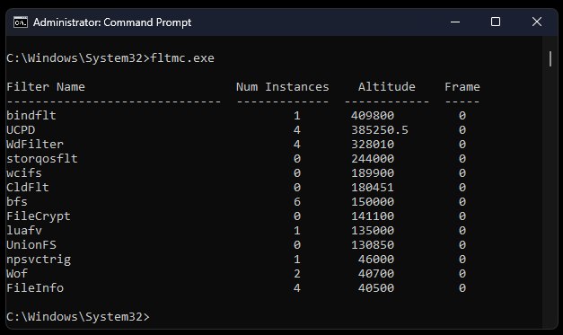

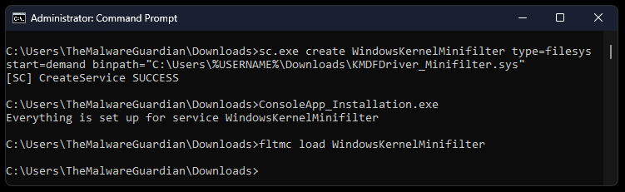
Hide Folders
VI
“MiniFilters attach to the file system stack to filter I/O operations. Using a PreOperation callback (triggered before the file system processes a request), access to files or directories can be explicitly denied by returning STATUS_ACCESS_DENIED or FLT_PREOP_COMPLETE. In the PostOperation callback (triggered after the request finishes), the DirectoryBuffer - which temporarily holds the directory listing - can be modified to remove specific entries, effectively making files and folders invisible to user-mode applications like File Explorer.”

Slide 25
Hide Folders
VI
“MiniFilters attach to the file system stack to filter I/O operations. Using a PreOperation callback (triggered before the file system processes a request), access to files or directories can be explicitly denied by returning STATUS_ACCESS_DENIED or FLT_PREOP_COMPLETE. In the PostOperation callback (triggered after the request finishes), the DirectoryBuffer - which temporarily holds the directory listing - can be modified to remove specific entries, effectively making files and folders invisible to user-mode applications like File Explorer.”
I/O Manager
Forwards request to file system
Filter Manager
Intercept requests and calls registered minifilters in altitude order
Minifilter A
FSFilter Activity Monitor
Altitude 360000
Minifilter B
FSFilter Anti-Virus
Altitude 320000
Storage Driver Stack for target volume
Prepares request for hardware
File System Driver
Processes and forwards modifies request
Minifilter C
FSFilter Encryption
Altitude 140000

Slide 26
Our Malicious Driver
Rootkit Development
User Mode - Kernel Mode Communication Toolkit
Direct Kernel Object Modification Hide Processes
Keyboard and Mouse Filter Keylogger
Windows Filtering Platform Network Control
Windows Kernel Sockets Network Requests
File System Minifilter Driver Hide Folders
ntddk.h
Communication
ntddk.h
DKOM
ntddk.h
Keyboard Filter
fwpmk.h, fwpsk.h, fwpmu.h
WFP
wsk.h
WSK
fltKernel.h
Minifilter

Slide 27

The Gateway
Rootkit Installation
Kernel Mode Driver

Slide 28
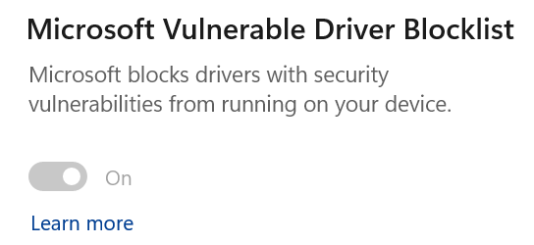
The Gateway
Rootkit Installation
Kernel Mode Driver
1. Vulnerable Kernel Driver (BYOVD)
Not Well Known
Bring Your Own Vulnerable Driver

Slide 29

The Gateway
Rootkit Installation
Kernel Mode Driver
1. Vulnerable Kernel Driver (BYOVD)
2. UEFI Bootkit Infect a Computer’s Boot process
Not Well Known
Bring Your Own Vulnerable Driver
SecureBoot
Physical Access

Slide 30



B / Rootkis In The Wild
2022
2024
MoonBounce
CosmicStrand
Fire Chili
Bootkitty
Fudmodule
2021
2023
ESPecter
FinSpy
Moriya
BlackLotus

Slide 31




Reverse Engineering / Malware Analysis /
Bug Hunting
Module 10 – Windows Reverse Engineering
• Windows architecture (User mode and Kernel mode) • Windows protections (DSE, KPP, VBS, CFG) • Malware hunting with SysInternals tools • Windows kernel opaque structures (EPROCESS, ETHREAD) • Windows kernel debugging • WinDbg scripting (Commands, Javascript, PyKd) • Rootkit hooking techniques (IDT, SSDT) • Rootkit development (Kernel Mode Drivers) • Bootkit development (UEFI Applications) • Bootkit analysis (ESPecter, BlackLotus) • Kernel exploitation (Vulnerable drivers, Write-What-Where)

Slide 32


Thank You ☺
Rootkits PoCs & ViCONgal 2025 PPT:
github.com/TheMalwareGuardian/Bentico
Every resource you need to develop Rootkits:
github.com/TheMalwareGuardian/Awesome-Bootkits-Rootkits-Development
Automate Bootkits/Rootkits Development
github.com/TheMalwareGuardian/Bootkits-Rootkits-Development-Environment
Contact:
www.linkedin.com/in/vazquez-vazquez-alejandro
Agradecimientos:

